Slide 1

Udemy Data Analysis

Slide 2

Why matplotlib.pyplot.scatter()
Matplotlib is a comprehensive library for creating static, animated, and interactive visualizations in Python. It is used for plotting various plots in Python like scatter plot, bar charts, pie charts, line plots, histograms, 3-D plots and many more. We will learn about the scatter plot from the matplotlib library.

Slide 3

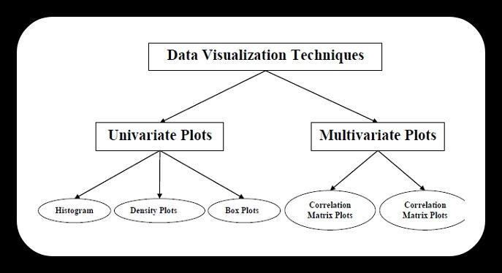
WHY WE USE ML FOR DATA VISUALIZATION OF UDEMY DATA -SHEET
To easily verify and visualization data and fast prediction.
To create engines that remove data that can cause massive diversion in dependencies (cleaning).
For engines that can help in analysis of further course of action that is to be taken in account keeping in mind the development of organization (Udemy in this case).

Slide 4
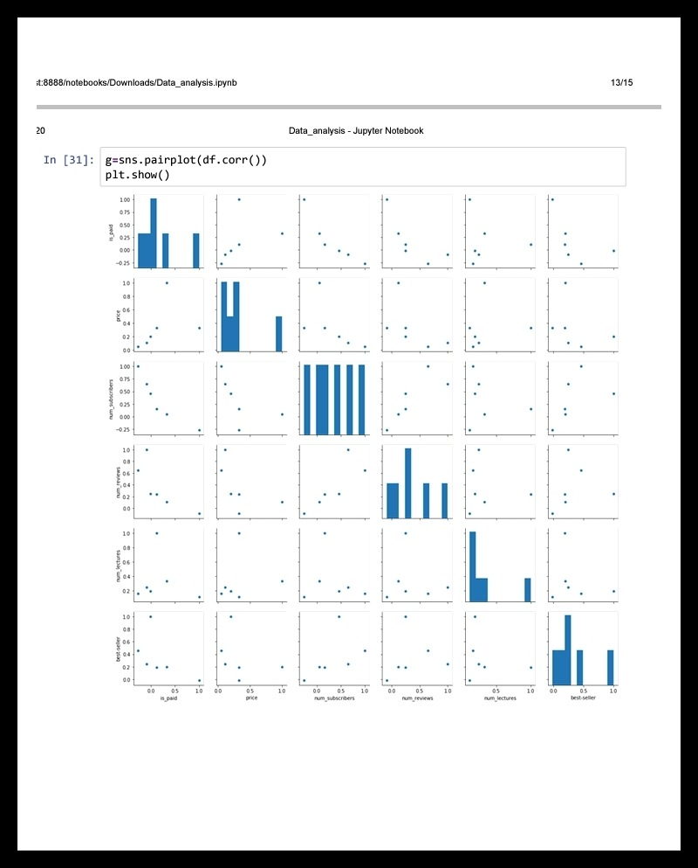
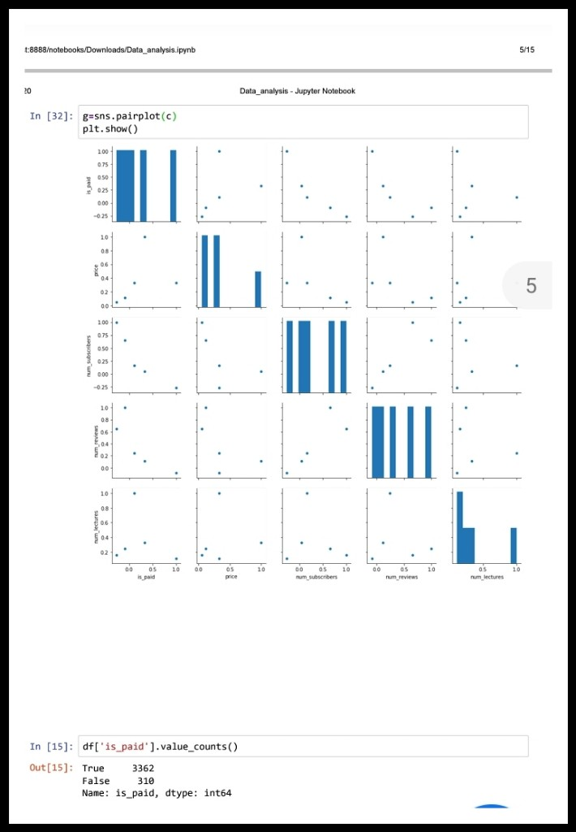
INSIGHTS
Variation of dataset can be easily observed and analysed through insights presented through graphs.
Here the modular approach of each unit data and comparison of dependencies can be easily observed and analyzed.
The variations predict the entire dataset clearing and further classify the approach taken for further analysis.

Slide 5

Method of Approach
Data-Set Analyzation
Creation of Initial Subsystem
01
04
02
03
Data Cleaning and prediction analysis
Creating Dependencies

Slide 6
VISUALIZATION METHOD (Scatter Plot)
A scatter plot is a data visualization that displays the values of two different variables as points. The data for each point is represented by its horizontal (x) and vertical (y) position on the visualization. Additional variables can be encoded by labels, markers, color, transparency, size (bubbles), and creating 'small multiples' of scatter plots. Scatter plots are also known as scatterplots, scatter graphs, scatter charts, scattergrams, and scatter diagrams.

Slide 7

Benefits of Python Language
Versatile, Easy to Use and Fast to Develop.
Open Source with a Vibrant Community.
Has All the Libraries You Can Imagine.
Great for Prototypes - You Can Do More with Less Code.
Speed Limitations.
Problems with Threading.
Not Native to Mobile Environment.

Slide 8

Importance
Relevance
Significance
https://drive.google.com/file/d/1y7b6-snKw9czmmgYVt0FgmLoaVKTtAoz/view?usp=drivesdk
Go to the link to explore more .
Visualization and insights in pdf form.

